Slide 1


SRI KRISHNA COLLEGE OF ENGINEERING AND TECHNOLOGY
KUNIYAMUTHUR, COIMBATORE-8
DEPARTMENT OF ELECTRICAL AND ELECTRONICS ENGINEERING
(Accredited by NBA)
THIRD REVIEW
SMART HYDROPONIC SYSTEM
TEAM MEMBERS
YUVARAJ S 19EUEE159
SHIVA SANKAR M M 19EUEE122
WASIM AKRAM B 19EUEE157
THANGA PANDIAN N 19EUEE144
SUPERVISOR
Ms. R. GEETHAMANI
Associate Professor/EEE

Slide 2
PROBLEM STATEMENT
The growing population is witnessing an increasing demand for food and water and this system would pave way for great productivity in the food as well as in water industries. Hydroponic farming is highly profitable.
It is an example of high yield just in a small place in any season or weather condition. Hydroponic vegetables are highly accurate and balanced in fiber, minerals, and vitamins. It is the first method of doing soil-less farming/cultivation

Slide 3
INTRODUCTION
Agriculture is the science or practice of farming to cultivate crops and raise animals to create useful products for humans. People began to travel from rural regions where agriculture was practiced to places where these industries were located due to the exponential expansion in population over a short period of time and the development of various different industries.
This resulted in the construction of cities, where other similar businesses were established, and this phenomenon known as urbanization resulted in many people performing occupations other than agriculture. As a result, subsistence agriculture could no longer support the population, and the agricultural sector required development.

Slide 4
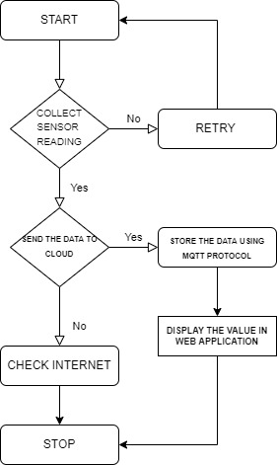
FLOWCHART :

Slide 5
The above figure represents the flow of data from the cloud to the web application which is built for the analysis of real-time data for the user in pictorial representation.
The data from the sensors are sent to the cloud via a microcontroller and with the help of an ESP module the data are transferred to the cloud, if the data are not transferred then the internet is verified.
The transferred data are stored using MQTT Protocol and are sent to the web application.

Slide 6
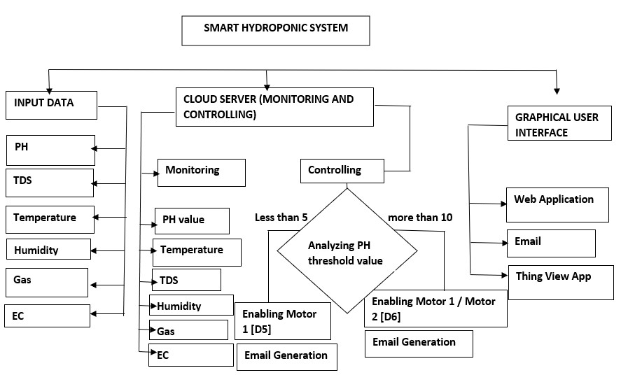
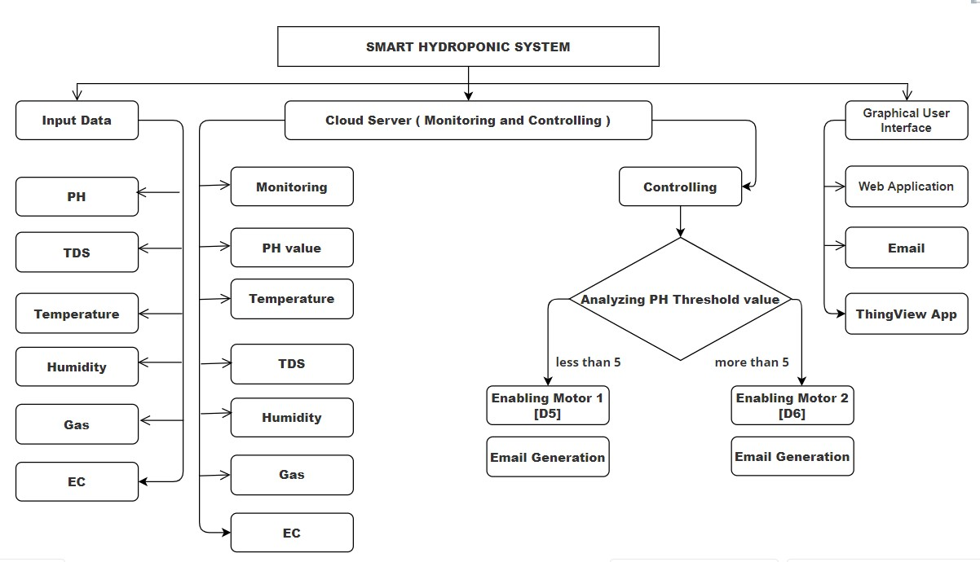
Smart Hydroponic system structure :

Slide 7
The working principle of the system implemented is explained with the help of the structure shown in Figure 2. The system's operation is divided into three primary components: input data, cloud server, and GUI.
The intelligent hydroponics system is made up of three primary components: input data, cloud server (monitoring and managing), and GUI. Starting with the input data, since IOT stands for the internet of things, a collection of objects, mainly sensors, connect with each other over a network, hence an IOT system requires a group of sensors.
The smart hydroponics system is made up of many sensors that collect data such as temperature, humidity, PH level, Gas, electrical conductivity, and TDS value in the aqueous solution. The internet of things is defined as the capacity to monitor and view data in real-time while also sending data and controlling settings through a network. To accomplish this, an MQTT, which stands for MQ Telemetry Transport, is a lightweight message protocol built for low bandwidth, high latency networks. The data collected in the cloud are being compared with their threshold value.
If the PH value goes less than 5 then motor 1 connected to pin D5 gets activated and if the value becomes more than 10 then motor 2 gets activated which is connected to pin D6 for achieving its limits for healthy plant growth.

Slide 8
The output data from the sensors is seen via the web application that has been created for the end user. The obtained output data is utilized to analyze the proper demands of the plants and crops that are being cultivated.
The web application pays way for the end user to acknowledge the level of essential as well as the system alerts the end user when there is an imbalance in the level of the nutrients in the aqueous solution or if any disturbances occur due to the environmental factors through an Email.
With this email facility, the end user could easily track which element has an imbalance in its threshold value.

Slide 9
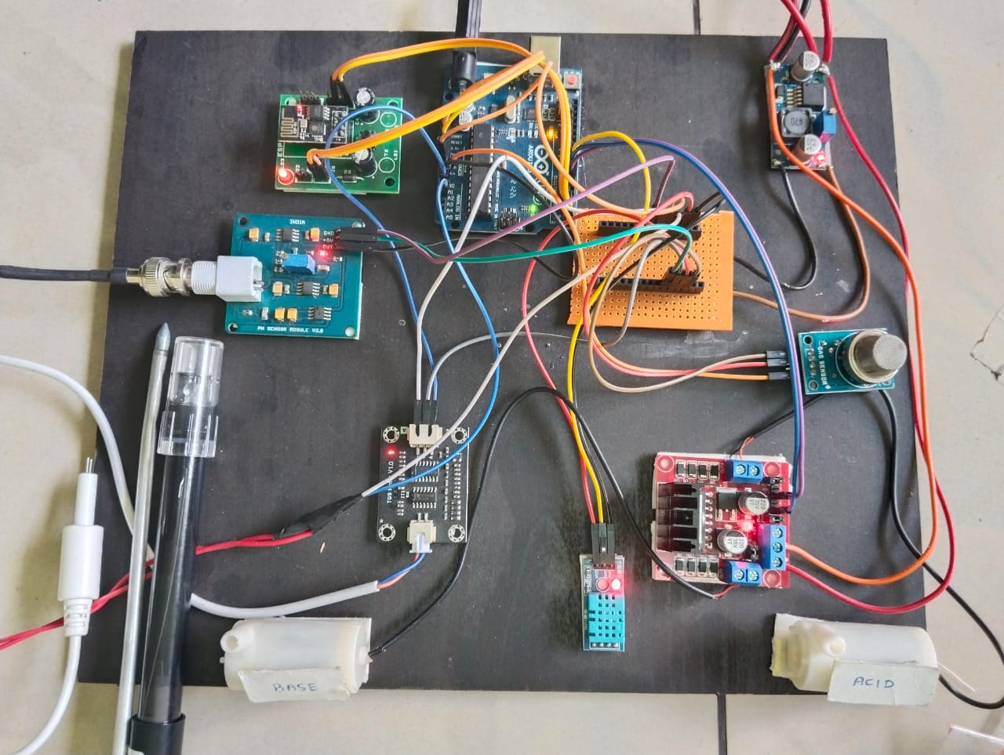
HARDWARE
S.NO | Pin | Sensor
1 | A0 | PH Sensor
2 | A1 | TDS Sensor
3 | A2 | EC Sensor
4 | D7 | Temperature Sensor
5 | A3 | Gas Sensor
6 | D7 | Humidity Sensor
7 | D5 | Motor 1
8 | D6 | Motor 2

Slide 10
The outcomes of hardware will be reviewed in this part. All the sensors have been connected in the Arduino Uno and have been programmed in order to monitor whether there are no changes in the reference values which have been already set for the effective growth of the plants.
If there occur any changes in the data from the sensor which is either lower or higher than the reference point then an email will be generated to the owner regarding the change in value and also the imbalance in the value will also be rectified if possible, automatically. Table 1 shows the pin connections of all the sensors with two motors which in this project act as an element for balancing the PH value which is essential for the growth of the plant.
At first, the real-time value from all the sensors are being sent to the cloud with the help of an ESP module and is transferred to the web application where the owner can view live data meanwhile the values are verified whether it lies between their threshold values and if not then the system acts accordingly to balance the values, here this hydroponic system has been built in such a way that when the PH value gets below 5 the motor which is connected to the pin D5 gets activated and if the PH value gets higher than 10 then the motor connected to pin D6 gets activated.

Slide 11
Since we use a 12 V adapter there is also a need for a buck converter that converts the 12 V to 5 V for the working of the sensors.
There are both analog and digital values that are being generated from sensors which are connected accordingly, such as the DHT sensor which gives Humidity and Temperature values of 16-bit data where the first 8 bits consist of Temperature value and the upcoming 8 bits consist of humidity values are connected to digital pins along with motors whereas the remaining sensors produces analog values which are connected to analog pins.

Slide 12
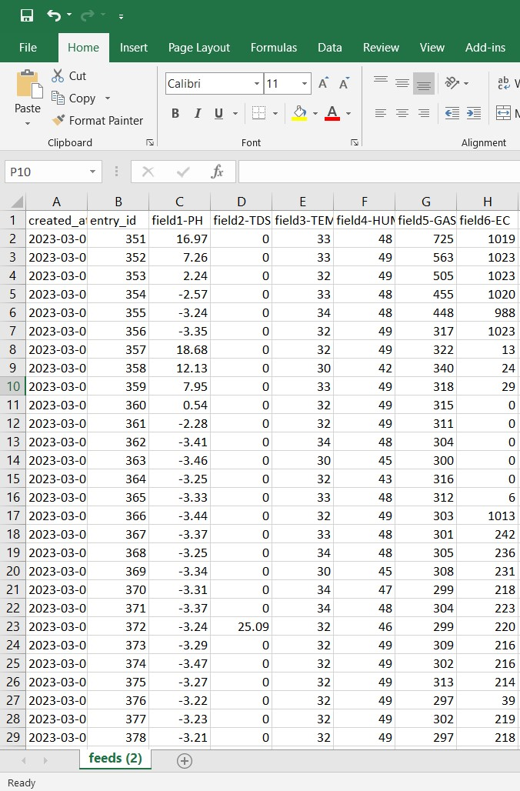
CSV FILE

Slide 13
The above figure represents the data’s for analyzing the fluctuation in the values from the sensors which help in understanding the level of changes over the period of time due to environmental changes. This helps the owner to calculate their essential precaution for the well-being of plant’s growth. The file is emanated in csv format from thing speak application in channel 2055181. There occur 6 fields which represent six sensor data as PH, TDS, Temperature, Humidity, Gas, and EC accordingly.

Slide 14
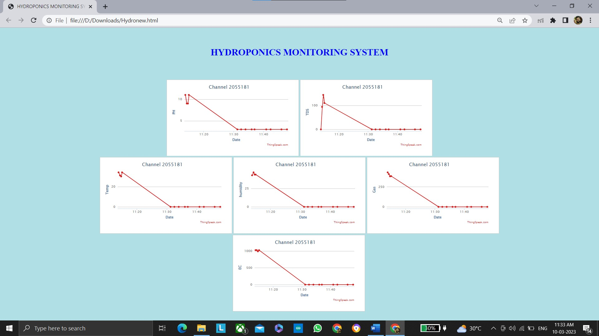
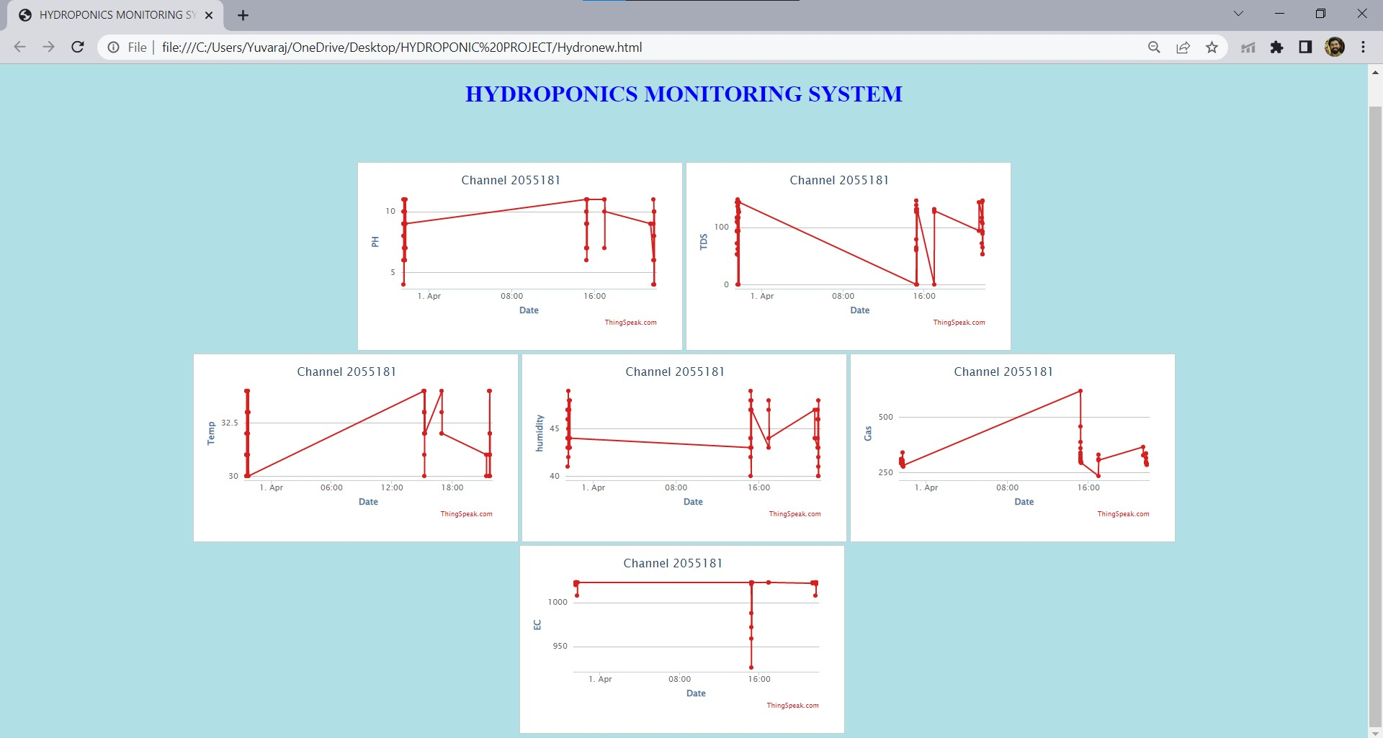
WEB APPLICATION :

Slide 15
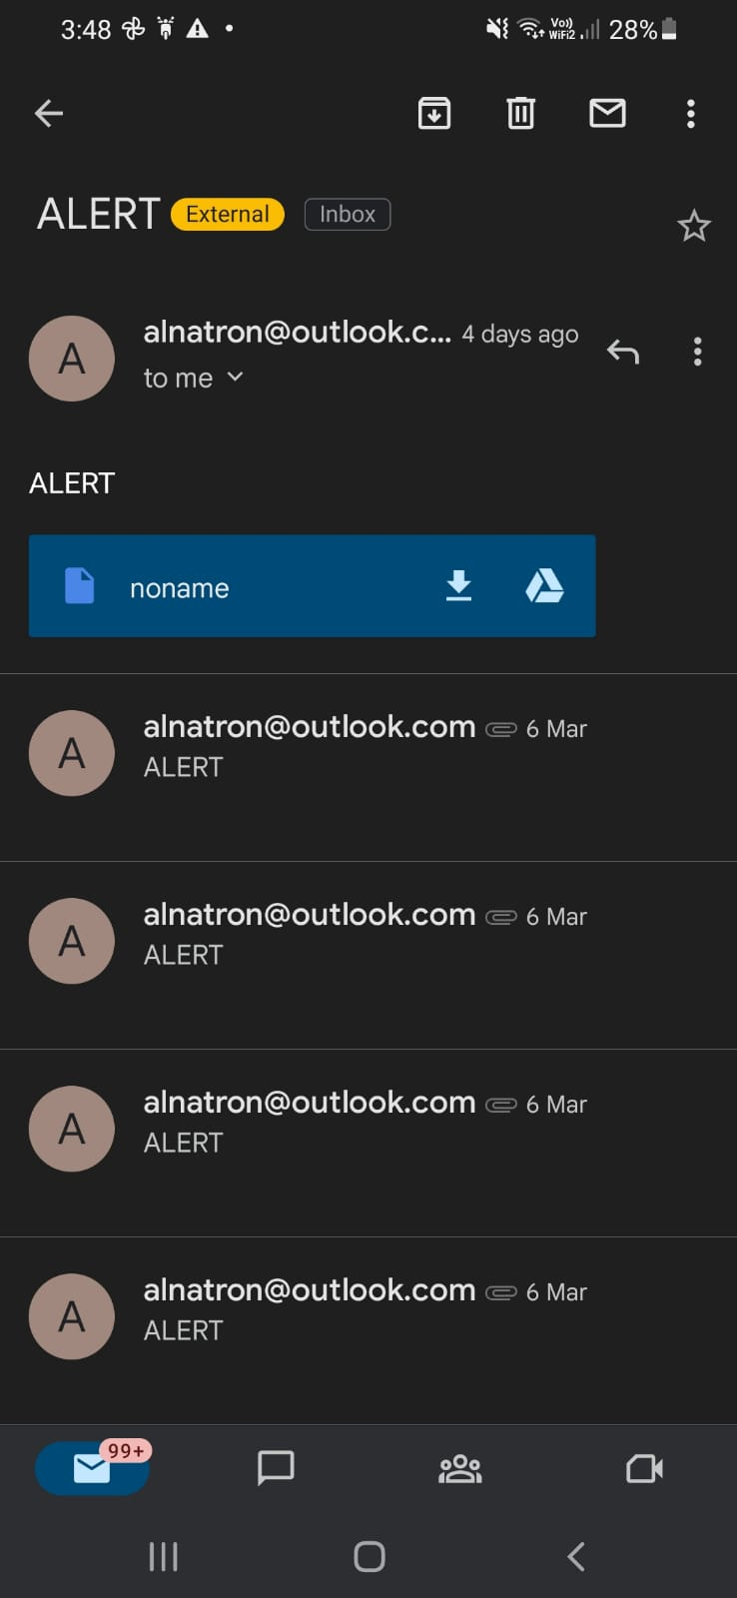
Smart hydroponic system Alert Notification to the owner :

Slide 16
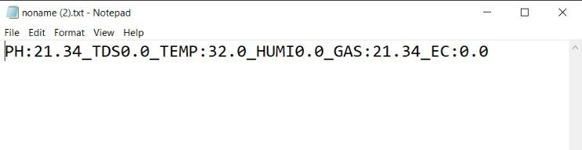
Above Figure 5 shows the alert mail which has been received by the owner due to the imbalance in the PH level [below 5 or above 10] which is caused due to environmental factors. The mail received by the owner will have an attachment that consists of all the values being measured, which is shown in below figure.

Slide 17
LITERATURE REVIEW
S.No | AUTHOR & YEAR | TITLE OF THE PAPER | REMARKS
1 | T. Namgyel, S. Siyang, C. Khunarak, T. Pobkrut, J. Norbu, T. Chaiyasit and T. Kerdcharoen, (2018) | IoT-based hydroponic system with supplementary LED light for smart home farming of lettuce | Provides knowledge about hydroponic framing.
2 | Falmata Modu, Adam Adam, Farouq Aliyu, Audu Mabu, and Mahdi Musa(2020) | A Survey of Smart Hydroponic Systems | Gives the knowledge about various methods in Hydroponics framing

Slide 18
REFERENCES
Kunyanuth Kularbphettong, Udomlux Ampant, and Nutthaphol Kongrodj, "An Automated Hydroponics System Based on Mobile Application," International Journal of Information and Education Technology, Vol. 9, No. 8, August 2019.
Srinidhi H K, Shreenidhi H S, and Vishnu G S, "Smart Hydroponics system integrating with IoT and machine learning algorithm," 2020 5th International Conference on Recent Trends on Electronics, Information, Communication & Technology (RTEICT-2020), November 12th & 13th 2020.
V. Palandea, A. Zaheera, and K. Georgea, “Fully automated hydroponic system for indoor plant growth,” Procedia Computer Science, vol. 129, 2018, pp. 482–488.
P. Sihombing, N. A. Karina, J. T. Tarigan, and M. I. Syarif, “Automated hydroponics nutrition plants systems using arduino uno microcontroller based on android,” presented at 2nd International Conference on Computing and Applied Informatics 2017, IOP Conf. Series: Journal of Physics: Conf. Series 978, 2018, p. 012014.

Slide 19
THANK YOU

